Slide 1
TECH LAYOFF ANALYSIS
PRESENTATION OF
BY VICTORIA JAJA

Slide 2
Tech Layoffs: What's Happening?
The tech industry is known for growth and innovation, but lately, layoffs have been making headlines. From big companies to startups, many are cutting jobs.
Using a tech layoffs dataset, I’ll break down which companies are affected, what stage they’re in, and whether we can spot patterns to predict future layoffs.
More importantly, I'll highlight insights that can help companies make smarter workforce decisions and create more stability.
INTRODUCTION

Slide 3
Understanding the impact of workforce reductions across different segments of the tech industry.
INTRODUCTION

Slide 4

OBJECTIVES
When are layoffs happening?
Which sectors are most affected?
Which companies are cutting the most jobs?
Why are companies laying off employees?
Recommend workforce planning strategies to mitigate future disruptions.

Slide 5
RECOMMENDATIONS

Slide 6
DATA CLEANING

Slide 7
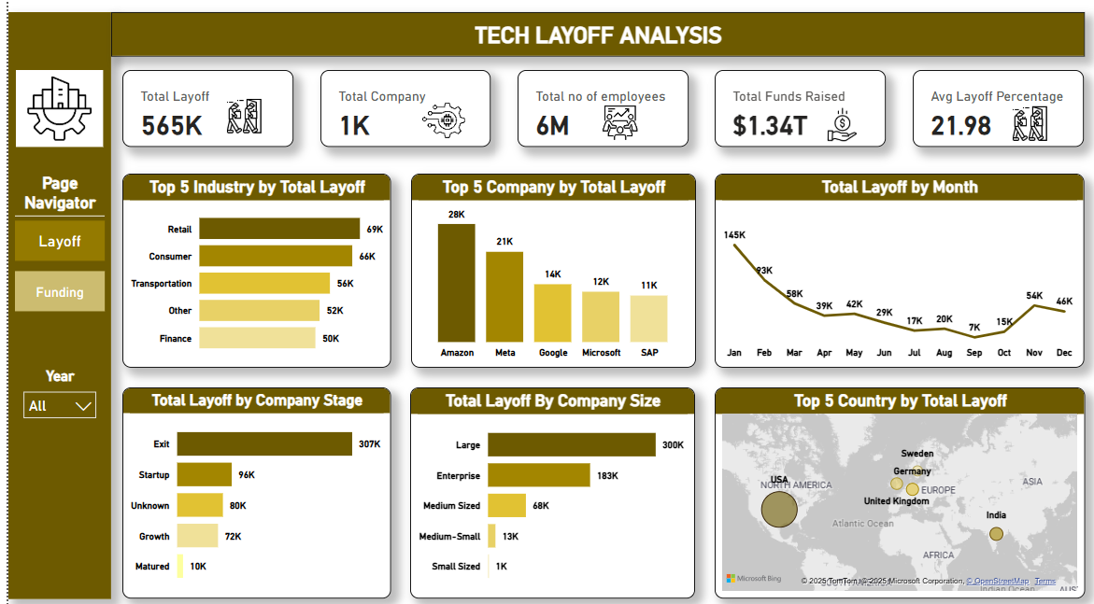
DASHBOARD

Slide 8
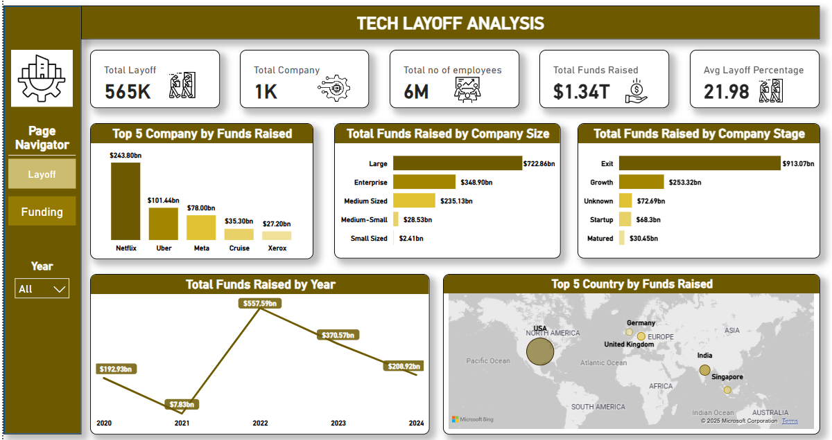
DASHBOARD

Slide 9
